Slide 1

Drivers of App Performance on Google Play Store
Team 9: Caroline Lun , Tavishi Pandey , Jon Sherman , Peixuan Liu

Slide 2
TABLE OF CONTENTS
01
PROBLEM
02
DATA SET
03
APPROACH
04
CONCLUSION & RECOMMENDATION

Slide 3


BUSINESS PROBLEM
Providing a detailed summary from App store Stats + Consumer Reviews to help Developers understand App Success

Slide 4
Google Play Store Data
TWO SECTIONS:
App performance features
“App”: App Name
“Category”: App Category
“Ratings”: App Ratings
“Review”: Number of Reviews
“Size”: App Size
“Installs”: Number of Installs
The second dataset includes the top 100 most relevant reviews for each app
“Its boring I cant” → Archos File Manager
Best app.. keep to-do things, remind notes, schedules even set reminders... Really awesome !!” → Google Keep

Slide 5
Data Analysis Approach
STEP 1
STEP 2
STEP 3
STEP 4
Data Cleaning
PCA
Clustering
Sentiment
Dropping null values, and creating dummy variables
Dimensionality Reduction
Using numeric data in both datasets, including sentiment analysis
Understanding sentiment of reviews

Slide 6
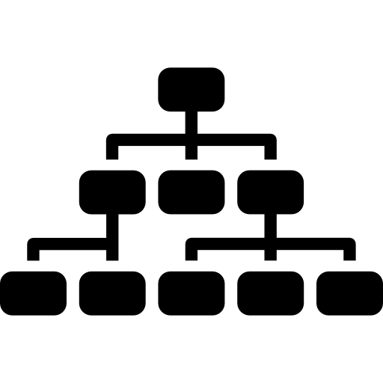
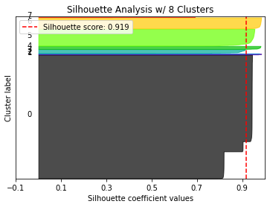
Clustering
The initial objective was to create clusters based on the numeric data and then proceeded to bring the reviews table in to help profile the clusters.
Hierarchical Clustering:
Was not the most accessible method to identify clusters with this kind of dataset
Use of dummy variables made it more difficult to decipher clean groups in the data
K Means:
Provided a better look into potential clusters
Used variable standardization and the data and use dimensionality reduction through PCA.
Issue: majority of the data was in one large cluster

Slide 7
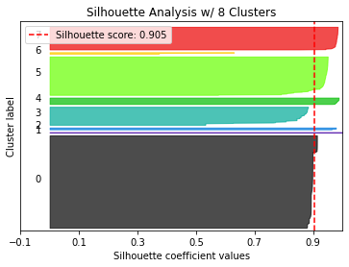
Improved Clustering
The second approach in an attempt to improve the clustering process was to leverage the sentiment scores from the reviews table to help cluster the apps.
K Means:
With the revised clustering, it was observed that there still was one large cluster; however, it was substantially smaller than it was with the prior method.
Profiling:
While profiling provided insight into a few key trends, for eg. more reviews for an app, i.e. more exposure comes with a mixture of high and low ratings, it was not an accessible solution to understand what drives app performance
Further analysis of the variables without trying to fit the results into clusters might be most insightful for app developers.

Slide 8
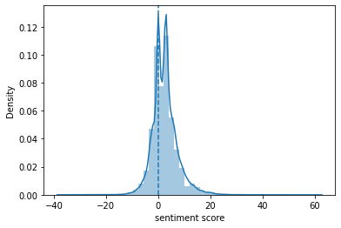
Sentiment Analysis
Overall:
+2.5 score
Game
Family &
Parenting
27M installs
3.17 score
4M; 3.92
Productivity
News & Magazines
10 M; 3.34
19.8 M installs
1.8 score
Notes:
The overall sentiment scores are positive, indicating that apps on the Google Play platform gained positive feedback on average.
Game

Slide 9
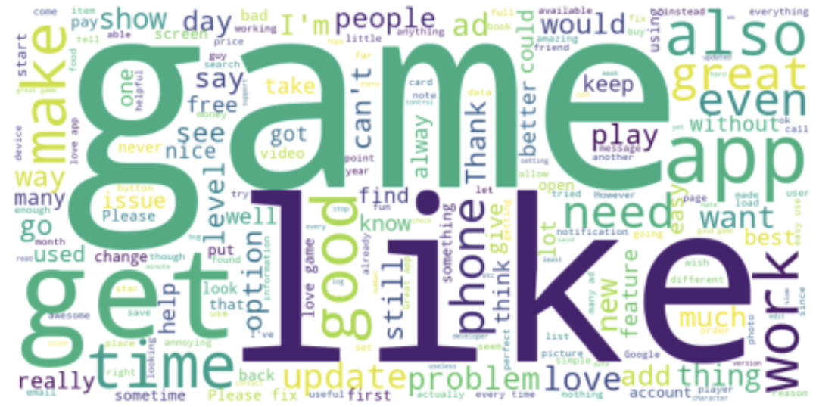
Word Cloud
Top keywords from all app reviews after removing stopwords
Notes:
The word cloud shows the top keywords in all app reviews, from which we can see ‘game’ is the most outstanding word. It’s probably because most apps are in the game categories and users of game apps are more willing to leave a review.

Slide 10
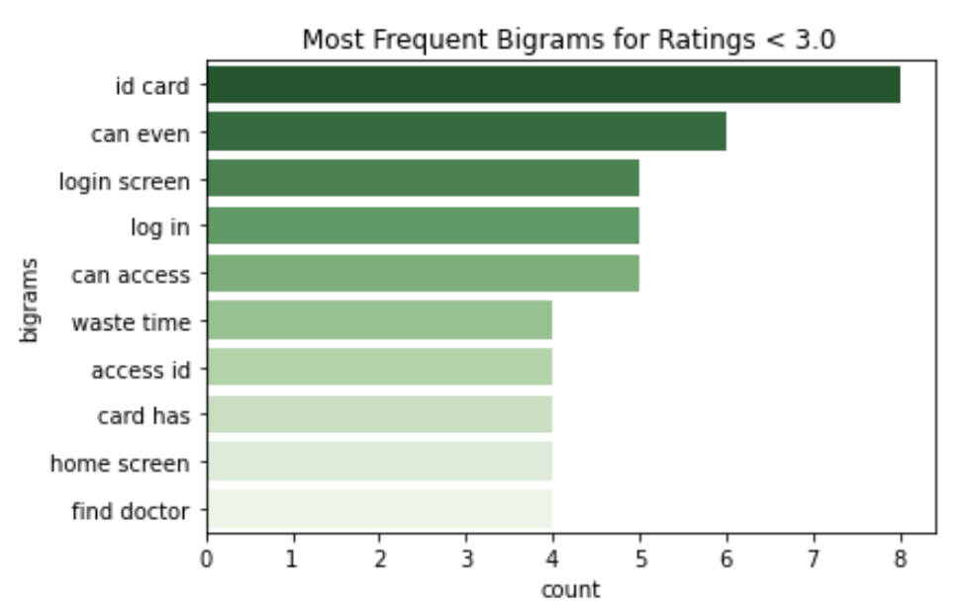
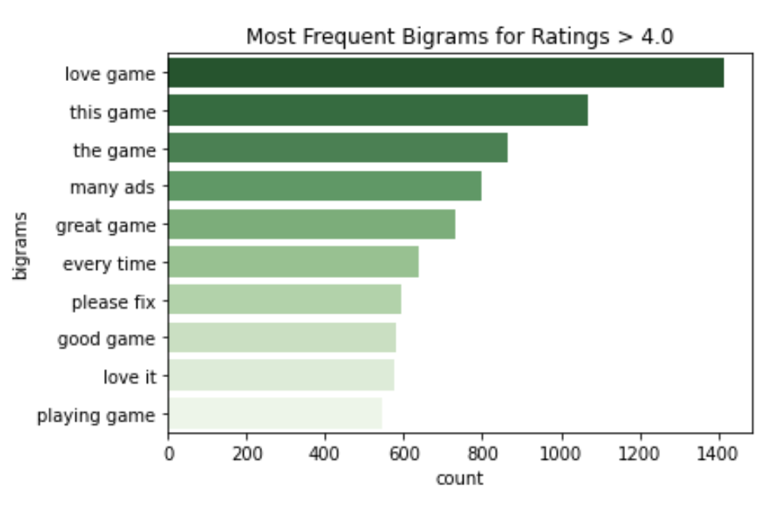
Bigrams Frequency
For low rating apps (<3.0), we notice a lot of complaints about id card, can’t log in and can’t access the apps
Reviews for high rating apps (>4.0) received primarily positive reviews like love this game, great game, etc.
Notes:
It suggests that app developers need to pay high attention to offer users with timely technical support to fix bugs and make sure users can use the apps easily.
Conversely, reviews for high rating apps received primarily positive reviews like love this game, great game, etc., which indicates that game apps tend to have higher ratings.

Slide 11
Conclusion
The clustering profiles in this case is not ideal to measure what drives app performance.
Apps at the Android market on Google Play Platform overall gain positive feedback from users
" Game”, “Productivity”, “Family”, “Parenting”, and “Health and Fitness” show great combined performance regarding to their number of installs, rating, number of reviews, and sentiment score.
Notes:
Game category app has larger market demand
Solely relying on the clustering profiles is not ideal to measure what drives app performance.
So we further conducted sentiment analysis

Slide 12
Recommendation
Our Choice: Productivity Apps
5th highest sentiment score
16th in number of apps in the store
3rd in number of Installs
7th in number of reviews
Additional Recommendations based on Developers Goals:
Most competition and positive reviews: Family or Games,
Most use but volatile reviews and low sentiment scores: News and Magazine
Few numbers of apps, High sentiment: Parenting
Additional Balanced option with less popularity: Health and Fitness.

Slide 13
THANKS!
Questions?
Please keep this slide for attribution

